Slide 1
Pitch Deck Template
This a generic template for pitching an early stage company for seed ($0.5M to $2.0M) venture capital investment. It is meant as only a guide, but does contain the key elements that VCs will expect to see. See comments in the Notes Section for more information which come from Garage Ventures – “Perfecting Your Pitch”.
.
Contents
Cover Slide
Team – The team that has the experience/expertise to own this opportunity
Company Overview - snap-shot overview of the company
Problem – The problem you solve and who you solve it for
Solution – Your solution with compelling benefits
Solution Delivery / Product – Your product and how it works in 3 simple steps
Benefits
Why Now – Secret Sauce
Competitive Advantage - Your competitors and why your product is better than theirs
Competition Matrix – Detailed list of competitors and how they are different
Market / Go to Market Strategy - Proof that your customers/users love your product
Business Model – How you make money
Financials -– What is your plan going forward? Who will you hire? What will you accomplish? How much will it cost?
Financing Needs / Use of Funds - How much money you need and what you will do with it
Summary – Huge opp. + Differentiated tech. + Dream team + Strong traction
(last updated 1/24/17)

Slide 2
Cover Slide: Company name, location, tagline, presenter’s name and title.
Notes:
If there are multiple team members participating in the pitch, put names on the next slide instead. Key objective: Everyone in the room should know the basic idea and value proposition of the company, including the target market, before the next slide is shown. All the words should not be on this slide, but with one or two sentences orally, reinforcing and extending the tagline, everyone should have a foundation for what is to come. Cardinal sin: Launching into your presentation with an investor at the table thinking, “I wonder what these guys do?”

Slide 3
TEAM
Notes:
The three or four key players in the company. For some reason, everyone puts the team slide at the end, but investors almost always want to know this at the beginning, and it is just common courtesy to make sure everyone is introduced. But make this short, crisp and relevant. This is not the time to share everyone’s life story, or detail the resumes of all six members of the advisory board. Focus on a significant, relevant accomplishment for each person that identifies that person as a winner. In 10 to 15 seconds, you should be able to say three or four sentences about your CTO that says everything the investors want to know about him or her at that moment. Key objective: Investors should be confident that there is a good credible core group of talent that believe in the company and can execute the next set of milestones. One of those milestones may be filling out the team, and so it is important to convey that the initial team knows how to attract great talent, as well as having great domain skills. If there is a gap in the team, address it explicitly, before investors have to ask about it.

Slide 4
COMPANY OVERVIEW
Notes:
The best way to give an overview of your company is to state concisely your core value proposition: What unique benefit will you provide to what set of customers to address what particular need? Then you can add three or four additional dot points to clarify your target markets, your unique technology/solution, and your status (launch date, current customers, revenue rate, pipeline, funding needed). Key objective: Flesh out the foundation you established at the beginning. At this point, no one should have any question about what it is that your company does, or plans to do. The only questions that should remain are the details of how you are going to do it. Another key objective you should have achieved by this point in your presentation is to make sure that if there are some compelling brand names associated with your company (customers, partners, investors, advisors), your audience knows about them. Feel free to drop names early and often—starting with your first email introduction to the investor. Brand name relationships build your credibility, but do not overstate them if they are tenuous.

Slide 5
PROBLEM
Notes:
You need to make it clear that there is a big, important problem (current or emerging) that you are going to solve, or opportunity you are going to exploit, and that you understand the market dynamics surrounding the opportunity—why does this situation exist and persist, and why is it only now that it can be addressed? Show that you really understand the very particular market segment you are targeting, and frame your market analysis according to the specific problem and solution you are laying out. In some cases, however, the problem you are attacking is so obvious and clear that you can drop this slide altogether. You do not have to tell investors that there are a lot of cell phones out there, or that teenagers like to socialize. Save yourself, and the investors, the pain of restating the obvious.

Slide 6
SOLUTION
Notes:
What specifically are you offering to whom? Software, hardware, services, a combination? Use common terms to state concretely what you have, or what you do, that solves the problem you’ve identified. Avoid acronyms and don’t try to use these precious few words to create and trademark a bunch of terms that won’t mean anything to most people, and don’t use this as an opportunity to showcase your insider status and facility with the idiomatic lingo of the industry. If you can demonstrate your solution (briefly) in a meeting, this is the place to do it.

Slide 7
SOLUTION DELIVERY / PRODUCT
Notes:
You might need an extra slide to show how your solution fits in the value chain or ecosystem of your target market. Do you complement commonly used technologies, or do you displace them? Do you change the way certain business processes get executed, or do you just do them the same way, but faster, better and cheaper? Do you disrupt the current value chain, or do you fit into established channels? Who exactly is the buyer, and is that person different than the user?

Slide 8
BENEFITS / VALUE
Notes:
State clearly and quantify to the extent possible the three or four key benefits you provide, and who specifically realizes these benefits. Do some constituents benefit more than others, or earlier than others? These dynamics should inform your go-to-market strategy, and your product/service roadmap, which you will discuss later.

Slide 9
SECRET SAUCE / IP / WHY NOW
Notes:
Depending on your solution, you might need a separate slide to convince investors that no one else can easily duplicate or surpass your solution (assuming that’s actually true). If you are in a business sector in which intellectual property is important, this is where you drill down into your secret sauce. This is usually some combination of proprietary technology, unique team domain expertise, and unique partnership. Boil this down to simple elements and terms, devoid of jargon. Do not walk the audience through a detailed tour of your product architecture. Instead, highlight the elements of your technology that give you unique potential for leverage and scale as you grow. If you do slides 4 and 5 well, it will be easy to make the case for your technology.
This is also a good time to talk about Why Now? Whether your innovation is based on technology or business model innovation you should assume that many companies have tried your approach before and failed. A key question for investors thus becomes why now? What has changed that allows for you to be successful where others have failed?

Slide 10
COMPETITIVE ADVANTAGE
Notes:
You may be good, but are you really better than everyone else? Most entrepreneurs misunderstand the objective of this slide, which is not to enumerate all the deficiencies of the competition (as much fun as that may be). Just because you have really cool technology does not mean you will win. You need to convince the investor that lots of folks will buy your product or service, even though they have several alternatives. And don’t forget that the toughest competitor is often the status quo—most prospective customers can muddle on without buying your solution or your competitor’s solution. The best way to convince an investor that you really do have a better mousetrap is to have referenceable customers or prospects articulate in their own words why they bought or will buy your offering over the alternatives. Use this slide to summarize the three or four key reasons why customers prefer your solution to other solutions. Many entrepreneurs have been coached to use a four-square matrix that shows that they are in the upper right-hand quadrant, but this has become a joke in the venture community. Check-boxes are better, if they are not abused. Make sure your check-box criteria reflect the market’s requirements, not just your product’s features.

Slide 11
COMPETITION MATRIX
Notes:
Depending on how important the analysis of competitive players is in your market segment, you may need a detailed list of competitors by category with their strengths and weaknesses in comparison with your company. Preferably, you develop this as a “pocket slide” to be used for Q&A, if necessary. Whether or not you present this slide, it is important that you do your homework on the competition, and that you don’t misrepresent their strengths or their weaknesses.

Slide 12
GO TO MARKET STRATEGY
Notes:
The single most compelling slide in any pitch is a pipeline of customers and strategic partners that have already expressed some interest in your solution—if they haven’t already joined your beta program. Too often this slide is, instead, a bland laundry list of standard sales and marketing tactics. You should focus on articulating the non-obvious, potentially disruptive elements of your strategy. Even better, frame your comments in terms of the critical hurdles you need to get over, and how you are going to jump them. If you don’t have a pipeline, and there is nothing unique or innovative about your strategy, then drop this slide and make the elements of your sales model clear in the discussion of your business model (next slide).

Slide 13
BUSINESS MODEL
Notes:
How do you make money? Usually by selling something for a certain price to certain customers. But there are lots of variations on the standard theme. Explain your pricing, your costs, and why you are going to be especially profitable. Make sure you understand the key assumptions underlying your planned success and be prepared to defend them. What if you can’t sustain the price? What if it takes twice as long to make each sale? What if your costs don’t decline over time? Many investors will want to test the depth of your understanding of your business model. Be ready to articulate the sensitivity of your business to variations in your assumptions.

Slide 14
FINANCIALS
Notes:
The two previous slides above should come together neatly in your five-year financial projections. You should show the two or three key metrics that drive revenues, expenses and growth (such as customers, unit sales, new products, expansion sales, new markets), as well as the revenue, expense, profit, cash balance, and headcount lines. The most important thing to convey on this slide is that you really understand the economics and evolution of a growing, dynamic company, and that your vision is grounded in an understanding of practical reality. Your financials should tell your story in numbers as clearly as you are telling your story in words. Investors are not focused on the precision of your numbers; they’re focused on the coherence and integrity of your thought process.

Slide 15
FINANCING REQUIREMENTS
Notes:
It should be clear from your financials what your capital requirements will be. On this slide you should outline how you plan to take in funding—how big each round will be, and the timing of each—and map the funding against your key near-term and medium-term milestones. You should also include your key achievements to date. These milestones should tie to the key metrics in your financial projections, and they should provide a clear, crisp picture of your product introduction and market expansion roadmap. In essence, this is your operating plan for the funds you are raising. Do not spend time presenting a “use of funds” table. Investors want to see measures of accomplishment, not measures of activity. And they want to know that you are asking for the right amount of money to get the company to a meaningful milestone.

Slide 16
SUMMARY SLIDE
Notes:
This slide is almost always wasted. Most entrepreneurs just put up three or four dot points about how wonderful their investment opportunity is. Generally the words are the same words that investors hear from scores of other entrepreneurs, such as, “We have a huge opportunity, and we will be the winners!” Your key objective on this slide is to solidify the core value proposition of your company in words that are memorable and unique to your company. If the venture investor in the room has to give a short description of your company to his partners, these are the words you want used. This is a good place to reinforce your tagline, or mantra—the short phrase that captures the essence of your message to investors. The best solution to creating your summary slide is to imagine that this is the only slide you will ever be able to present. If you had to do your whole pitch in one slide (with 30 point font), this is that slide.
So here we have a good general outline for pitching your company. But remember, it’s about selling your investment proposition, not about covering points. Don’t get fixated on using this or any other template. You should know the issues about your company that investors are most concerned about. Those are the issues you need to concentrate on. Make sure you address all the predictable “burning questions” as early as you can in your presentation, even if it means violating the sequence above.

Slide 17
SAMPLE SLIDES

Slide 18
Company Overview – Example
What We Do
NewCo is a [zero-jargon description of product] used by [broad but addressable market] to [benefits]. We are focused on the [$X billion target niche] market.
Current Status
We are [company stage, e.g. pre-revenue, pre-launch, etc.].
Progress to Date
Quarter 1: X key metric, Y key metric
(Month or Quarter 2): X key metric, Y key metric
Currently Raising
[$X-Y million] seed round to supplement on [$xxxx] of [agency] funding
Team
Logos of Past Companies & Top Schools
Customers/Partners
Logos or Other Proof of Early Traction

Slide 19
Market Size- Example
Annual Directly Addressable Markets: ^{1,2}
Market
Annual Market Today
Annual Market Potential (’07 –’10)
MW
MM $
MW
MM $²
Light Commercial
-
-
1,140
960
Heavy-Duty Generators
14,800
12,400
16,660
14,000
Heavy Duty APUs
20
13
7,400
4,400
Non-Road Vehicles
3,575
2,145
4,350
2,610
Military
80
48
125
75
Total
18,475
14,606
29,675
22,045
¹ For all market segments (except the light commercial) the annual market potential corresponds to 100 % penetration of the available market (technical market). For light commercial, the addressable market is estimated to be 6 % of the available market.
² Based on appropriate mark-up of long-term factory cost of $ 400/kW. Mark-up was assumed at 2.1 for light commercial and generator markets, and at 1.5 for the other markets.
Sources: TIAX LLC & DOE SECA Presentation April 2003
19

Slide 20
Competition – Example
[Low property]
[High property]
[High property2]
Competitor A
NewCo.
[Low property2]
Competitor C
Competitor D
We are stronger than the competition in [key differentiators].
We are threatened by the competition in [honest worries you have].

Slide 21
Competition Matrix - Example
Notes:
Solar example.

Slide 22
Competition Matrix – Example
Comparison of the of Power Systems in the 3 - 50 kW Power Range
Attribute
NewCo - SOFC
Nickel-SOFC
PEMFC (hydrocarbon)
Internal Combustion Engine
Efficiency (%)
44 - 56
28-36
25-32
18-25
Capital Cost ($/kW)
350-500
400-500
900
400-500
Power Density (W/L)
75-100
65-80
35-70
20-40
Noise
Emissions
Start-up Time
Attribute Ranking:
Excellent
Moderate
Poor
Notes:
Fuel cell - example.

Slide 23
Financing: 3-Year Plan
 | 2016 |  |  |  | 2017 |  |  |  | 2018
Team head count | 3 | 4 | 4 | 4 | 4 | 5 | 5 | 5 | 6 | 6 | 6 | 6
Technology
Market
Financial burn ($k/mo) balance ($M) | 50 0.25 | 50 0.20 | 60 0.15 | 60 0.10 | 63 1.65 | 75 1.60 | 75 1.55 | 75 1.50 | 75 1.45 | 90 1.5 | 90 1.85 | 90 1.85
Key Hire 1
Key Hire 2
Key Hire 3
Milestone 1
Milestone 2
Milestone 1
Milestone 2
Seed
Series A

Slide 24
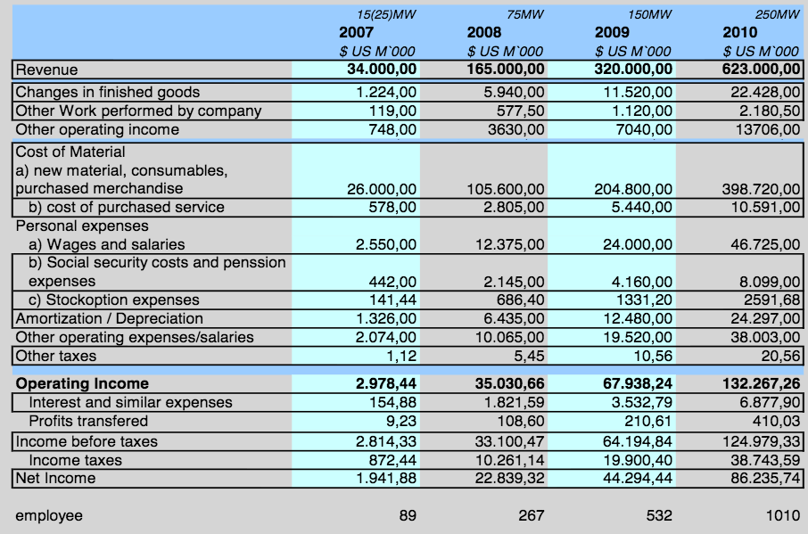
Financials – Example
Notes:
Sample financials from a solar start up.

